Slide 1




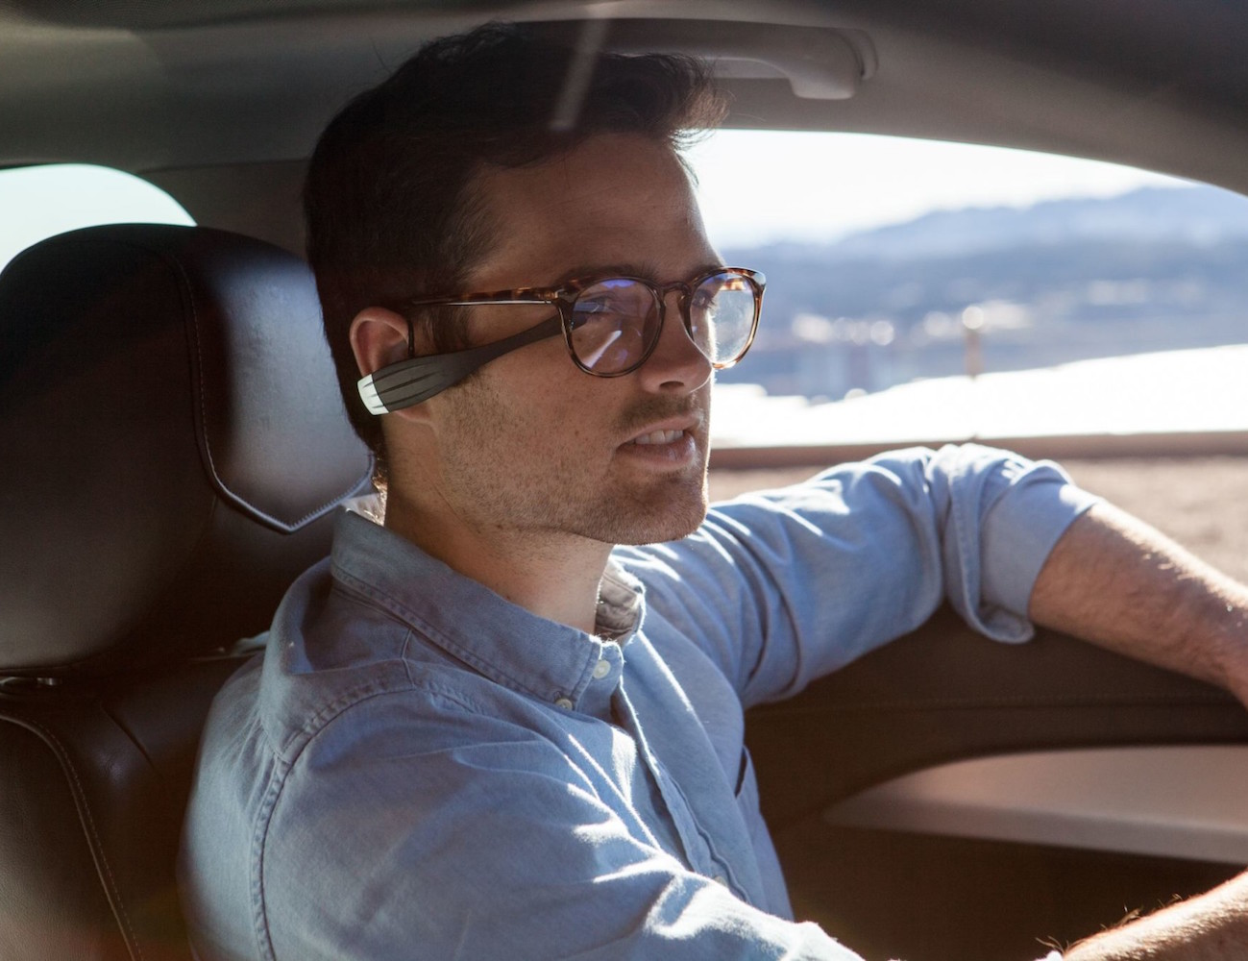
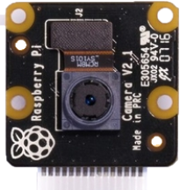
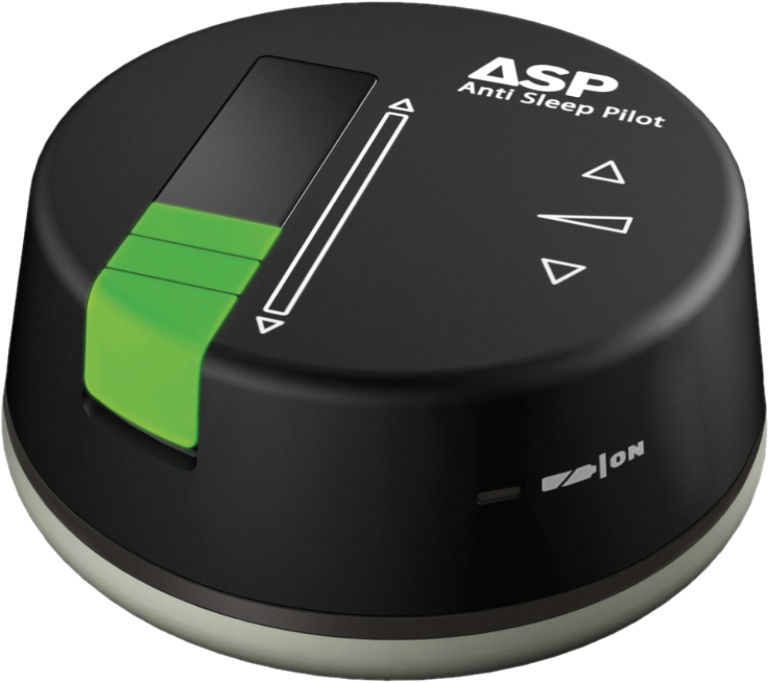

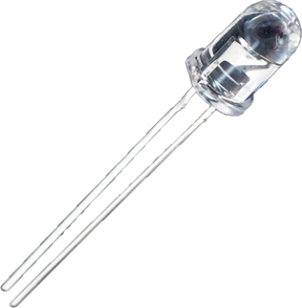






Flow Diagram
41% of drivers have reported having “fallen asleep or nodded off” while driving at least once in their lifetime
Crashes that occurred 11 PM – 7 AM were nearly five times as likely to have involved a drowsy driver
Facial Landmarks Identification
Eye Localisation
Initialization stage?
No
Video Capture
Preprocessing
Face Detection
Compute EAR
2.4% of all fatal crashes in the US involve a drowsy driver
SleePi
Real-Time Alertness Detection System
Yes
Exceeds Threshold?
Calibration
BEEP!
BEEP!
BEEP!
Yes
Send Sound Signal

Slide 2
References
Picture Credits:
Sale vector created by pch.vector - www.freepik.com
https://thegadgetflow.com/portfolio/vigo-the-stimulating-headset/
https://newatlas.com/anti-sleep-pilot-monitors-driver-fatigue/17439/
https://cdn.sparkfun.com//assets/parts/3/1/9/9/09469-1.jpg
Data Sources:
https://www.sleepfoundation.org/professionals/drowsy-driving
https://crashstats.nhtsa.dot.gov/Api/Public/ViewPublication/812446
https://aaafoundation.org/wp-content/uploads/2018/02/2010DrowsyDrivingReport.pdf
https://ph02.tci-thaijo.org/index.php/ECTI-EEC/article/download/215488/149943/

